Slide 1
Case Project 1
Observations on YouTube Dataset
Dushyant Pratap Singh
dushyant.singh@iitg.ac.in

Slide 2
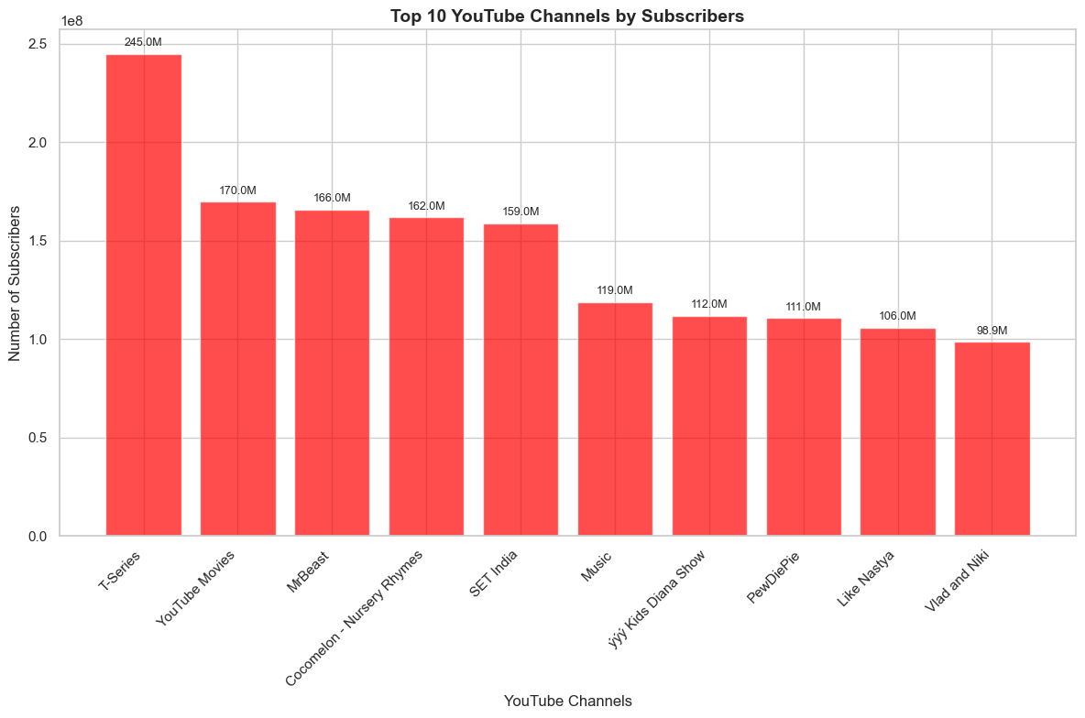
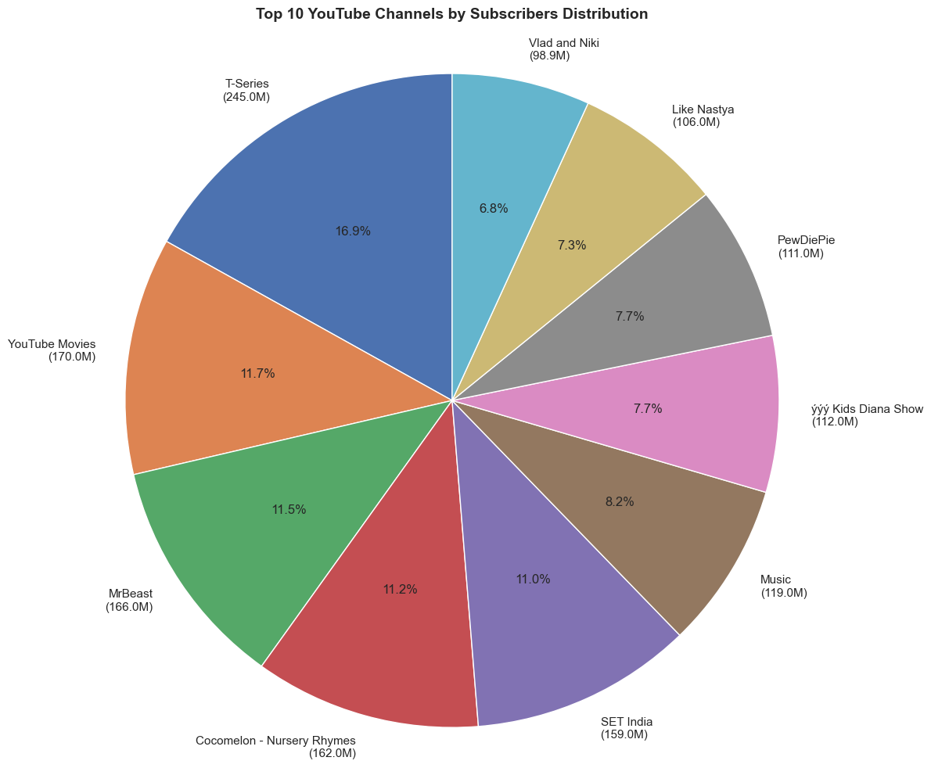
Top 10 YouTube Channels by Subscribers
T-Series is the clear leader among the top 10 YouTube channels by subscribers, commanding a substantial 16.9% share of the total subscriber base with 245 million subscribers.
Channels like YouTube Movies, MrBeast, and Cocomelon have similar subscriber numbers, with a gradual, not steep, drop-off down the list, as the bar chart visually demonstrates and the pie chart percentages reinforce.

Slide 3
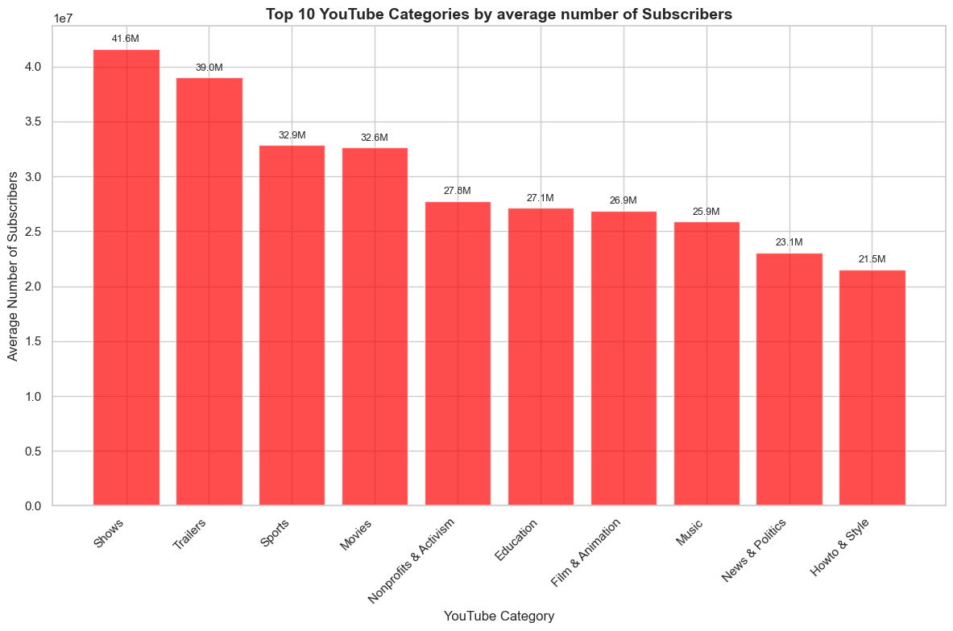
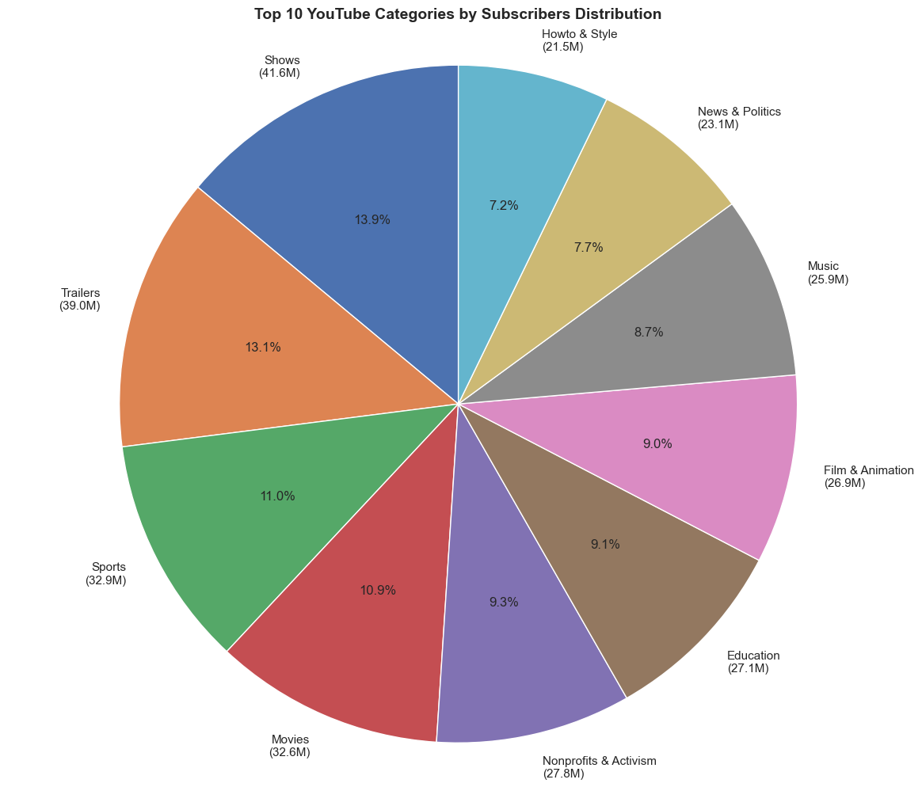
Category with highest average number of subscribers
The "Shows" and "Trailers" categories lead the top 10 YouTube categories by a significant margin, with an average of 41.6 million and 39.0 million subscribers, respectively.
This indicates a strong audience preference for curated content and previews, as these categories command the largest share of average subscribers among all categories represented.

Slide 4
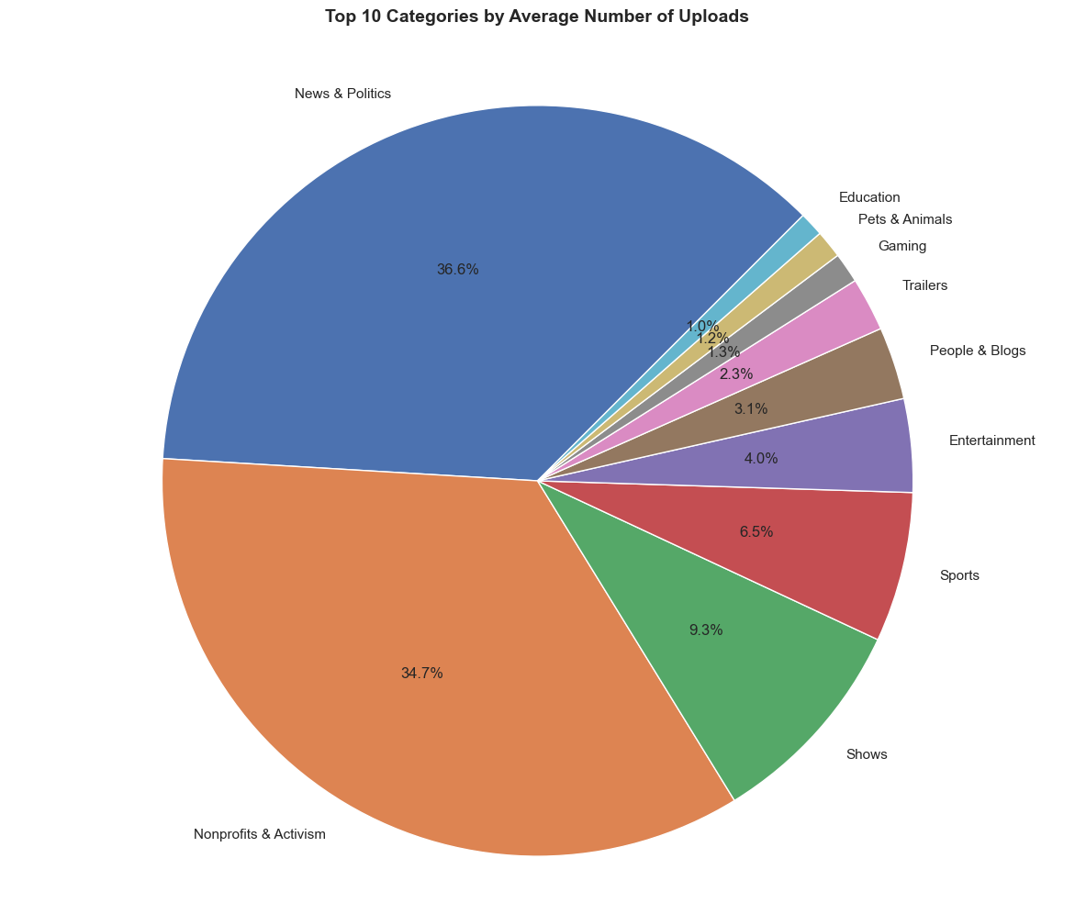
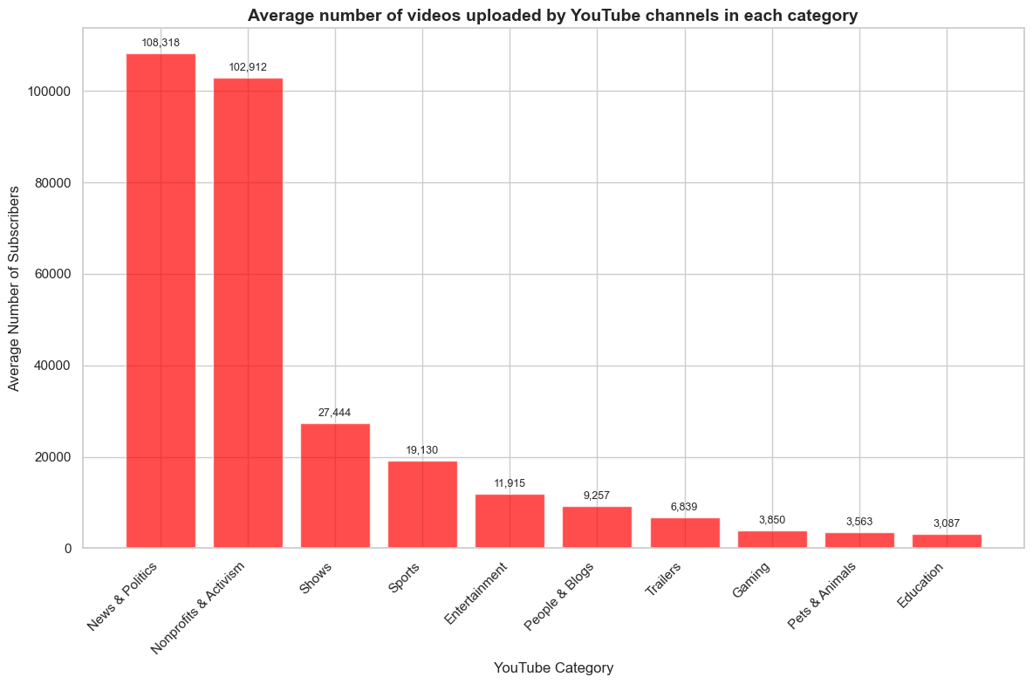
Average videos uploaded by YouTube channels
The categories "News & Politics" and "Nonprofits & Activism" have the highest average number of uploads per channel by a large margin.
This is evident in both the bar and pie charts, where these two categories represent over 70% of the total uploads among the top 10 YouTube categories. Their average uploads far exceed those of other categories.

Slide 5
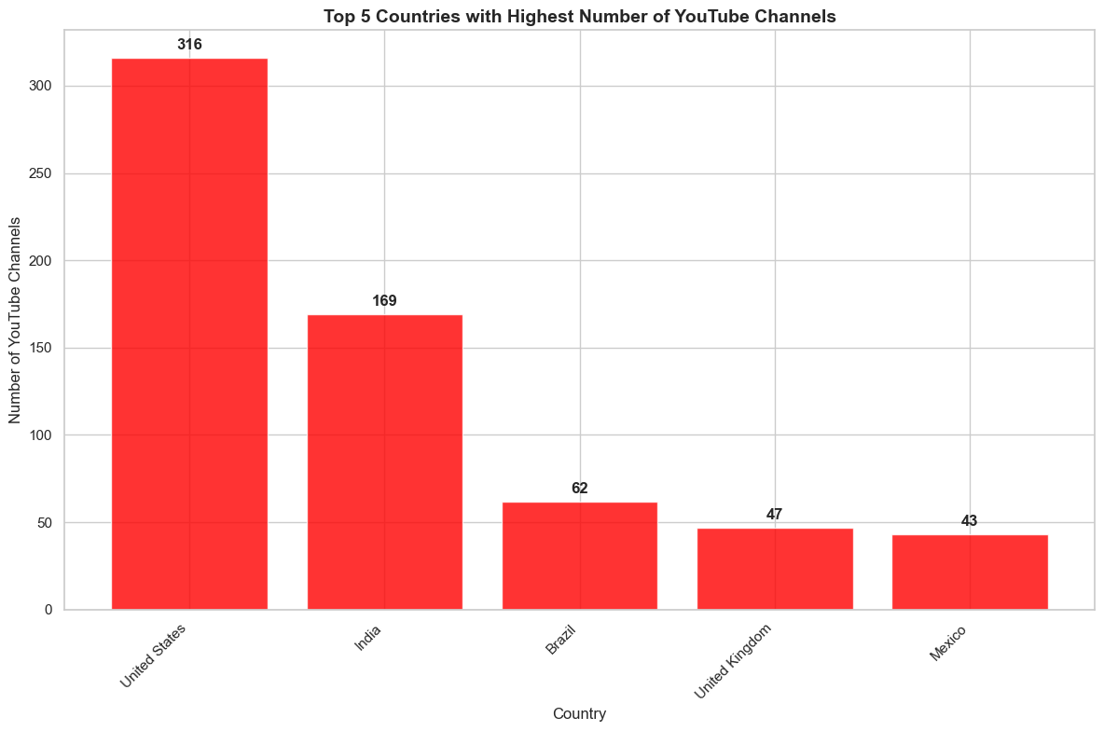
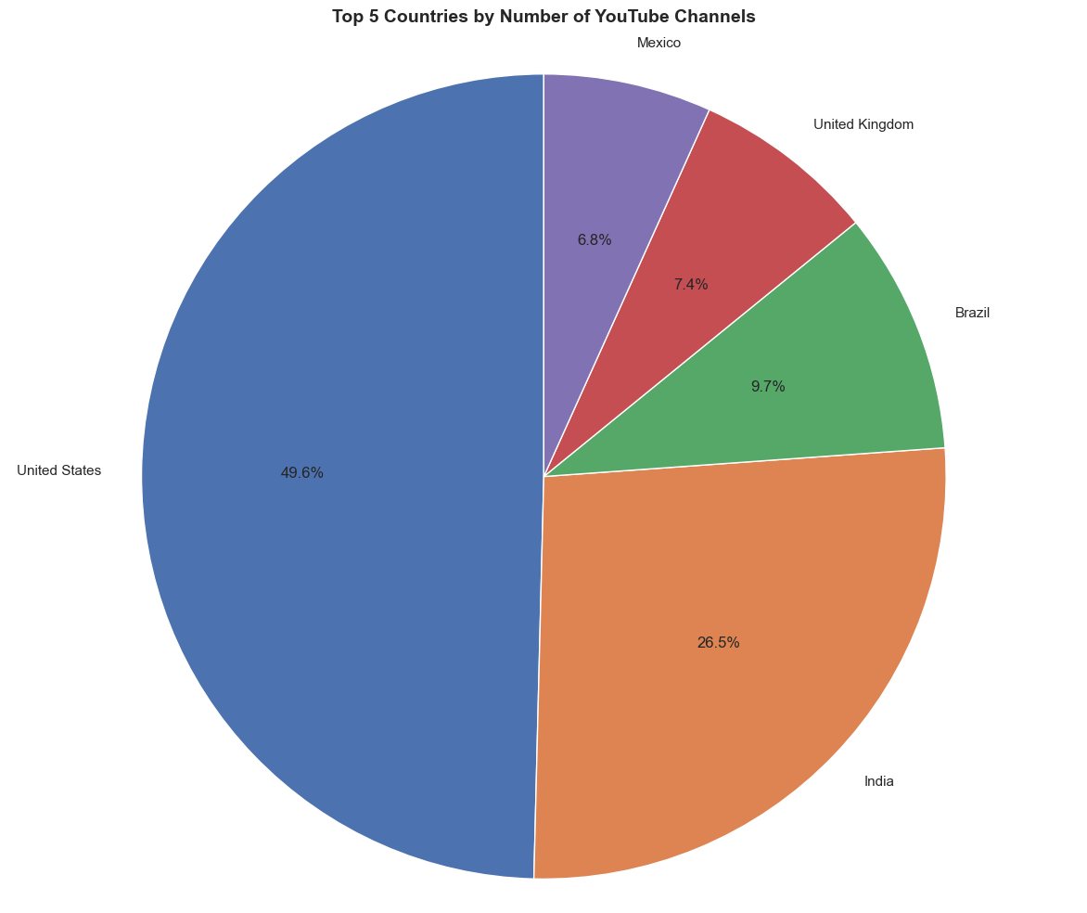
Top 5 Countries with Highest Number of YouTube Channels
The United States leads by a wide margin, accounting for almost half (49.6%) of the top YouTube channels among the top 5 countries. This dominance is clear in both the bar chart and the pie chart, reflecting a strong concentration of popular YouTube creators in the U.S.
After the United States (316 channels) and India (169 channels), the number of top YouTube channels per country declines significantly. Brazil, the United Kingdom, and Mexico have less than 20% each compared to the U.S., highlighting a major gap between the two leading countries and the rest.

Slide 6
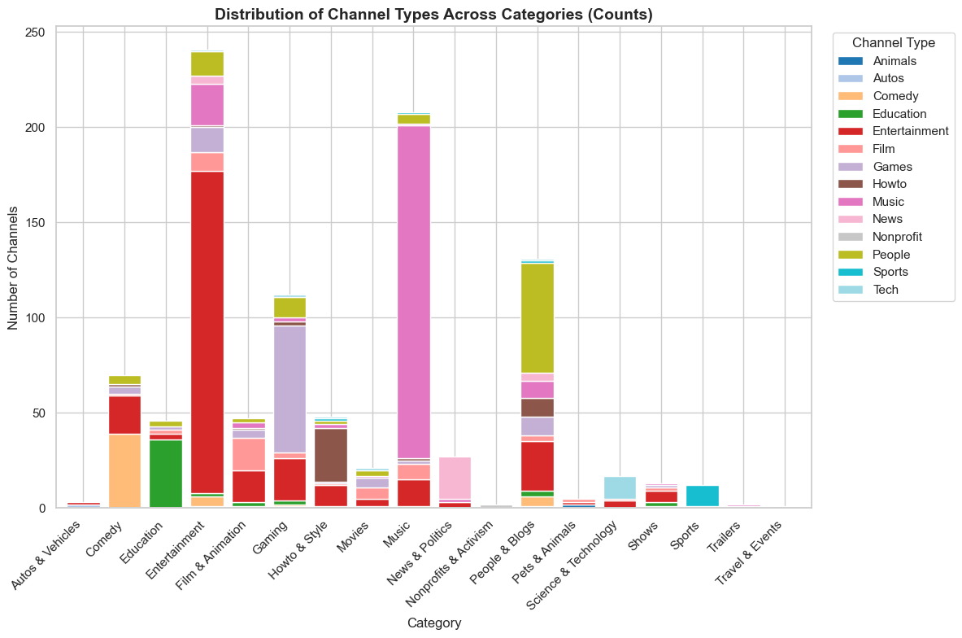
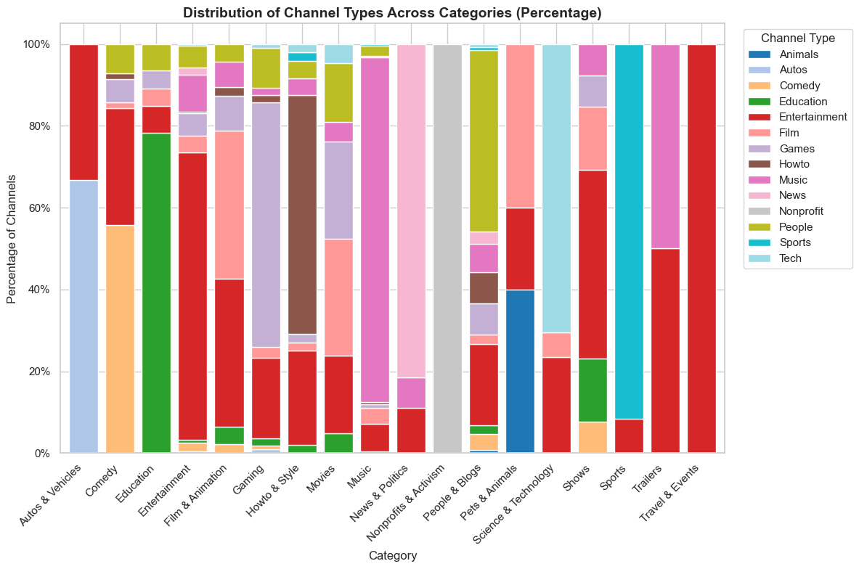
Distribution of channel types across different categories
The "Education" and "Music" categories have the highest number of channels, with "Education" showing the largest count overall. This suggests that these are the most popular or diverse categories for channel creation.
Several categories, such as "Shows," "Trailers," "Travel & Events," and "Pets & Animals," are almost entirely comprised of just one or two channel types, a single type accounts for nearly all the channels in its category—highlighting strong specialization versus the diversity observed in other categories like "Entertainment" or "People & Blogs."

Slide 7
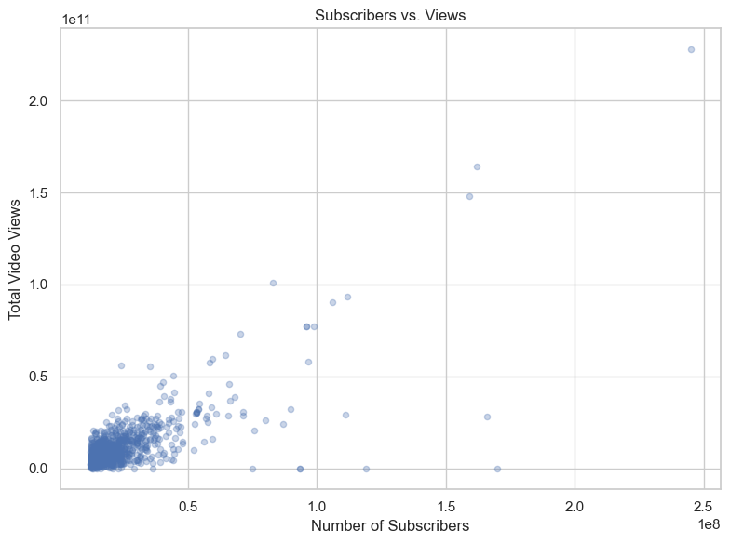
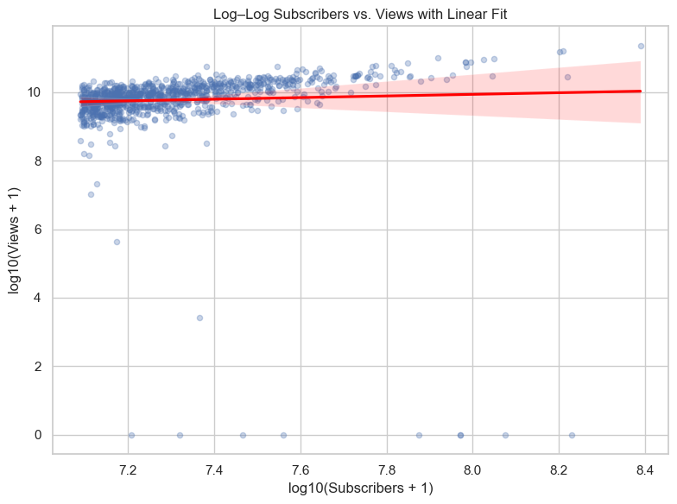
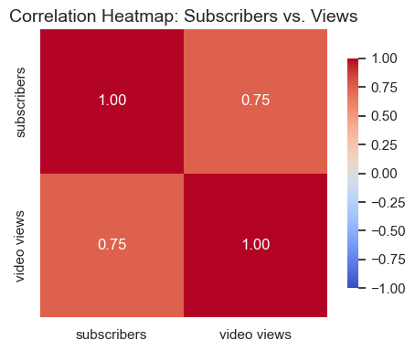
Correlation between the number of subscribers and total video views for YouTube channels
There is a strong positive correlation between the number of subscribers and total video views for YouTube channels. This is supported by the correlation heatmap, which shows a correlation coefficient of 0.75 between subscribers and video views. Both the raw and log-log scatter plots also show that as subscriber count increases, total video views generally increase as well.
Despite the overall positive relationship, the increase in video views does not strictly keep pace with subscriber growth, especially among larger channels. The log-log scatter plot with a linear fit reveals some outliers and considerable spread, indicating that while most channels follow the trend, a number of channels either outperform or underperform in terms of views relative to their subscriber count. This suggests that other factors—such as content type, engagement, or virality—also impact total views.

Slide 8
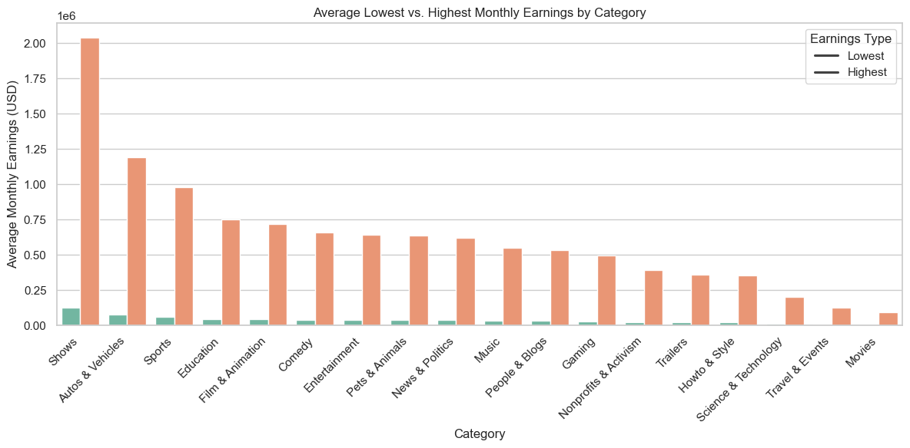
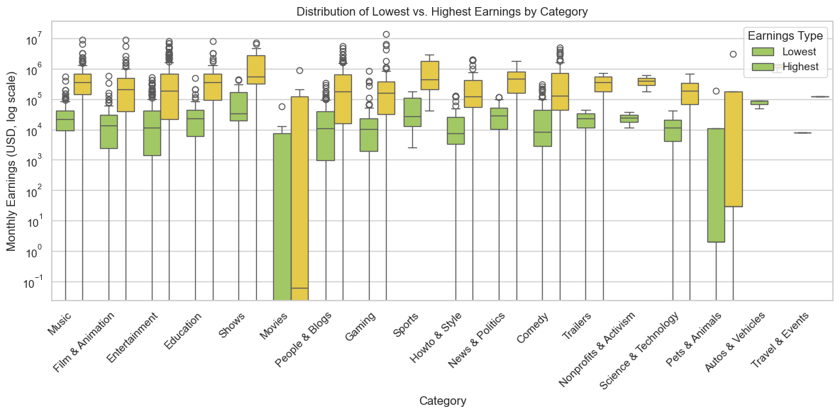
Monthly earnings variation throughout different categories
The "Shows" category has the highest potential for monthly earnings by a wide margin—with the top earners in this category reaching average monthly earnings over $2 million and a high overall spread, as seen in both the bar and box plots.
There is a significant gap between the lowest and highest earners within each category, with some categories such as "Autos & Vehicles" and "People & Blogs" showing especially wide variations—indicating that earnings potential can differ dramatically even among channels in the same category.

Slide 9
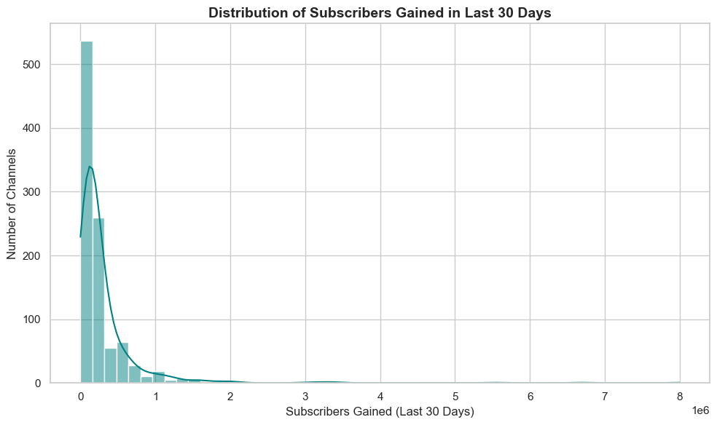
Overall trend in Subscribers gained in the last 30 days across all channels
The distribution of subscribers gained in the last 30 days is highly right-skewed, with the vast majority of channels gaining relatively few subscribers and only a small number of channels experiencing extremely high subscriber growth

Slide 10
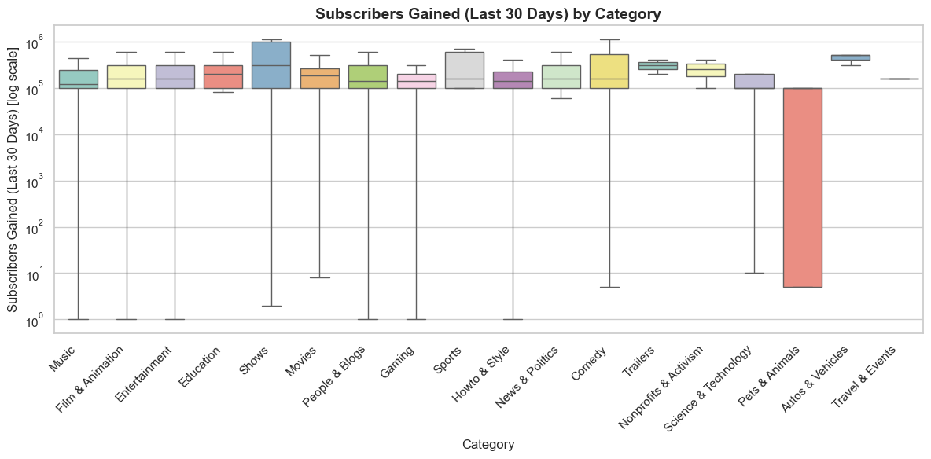
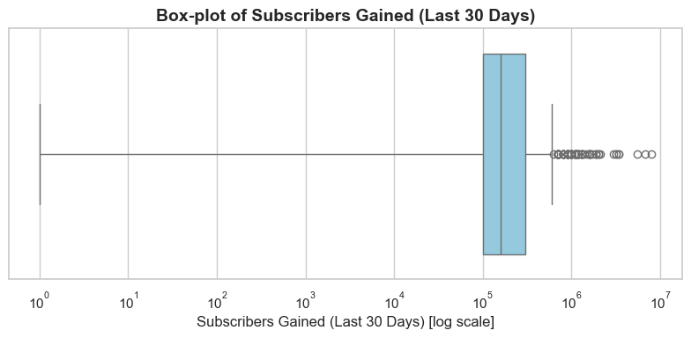
The number of subscribers gained in the last 30 days is highly skewed: While most channels gained between 103103 (1,000) and 106106 (1,000,000) subscribers, there are significant outliers on the higher end, as visible from the many points above the box in both plots, especially evident in the overall boxplot.
The "Shows" category stands out for having the highest variability and maximum subscriber gains among all categories: Compared to other categories, "Shows" exhibits both a higher median and a much larger spread, with some channels in this category gaining more than 106106 subscribers in the last 30 days

Slide 11
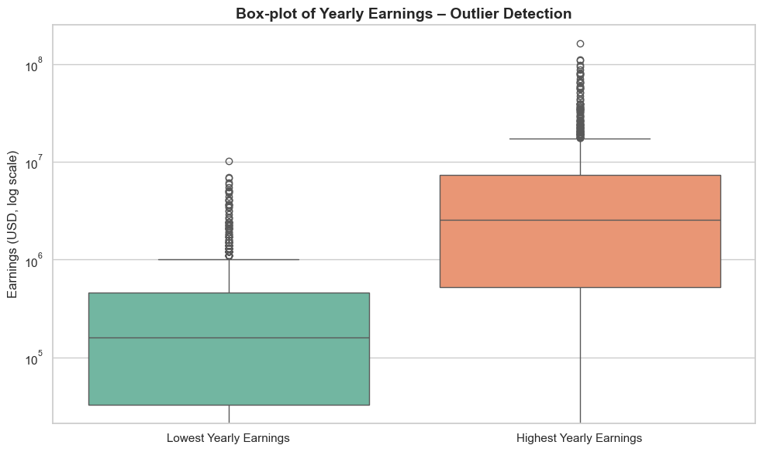
Outliers in terms of yearly earnings from YouTube channels
Highest yearly earnings are consistently much greater than lowest yearly earnings, with the median and interquartile range for the highest yearly earnings box significantly above those for the lowest yearly earnings. This demonstrates a substantial difference between channels’ earning potential depending on performance or estimation method.
Both distributions display a high number of outliers on the upper end, but the highest yearly earnings category has outliers reaching close to $100 million, while the lowest yearly earnings boxplot’s outliers peak below $10 million. This highlights the possibility of extreme top earners far exceeding what most channels make in a year

Slide 12
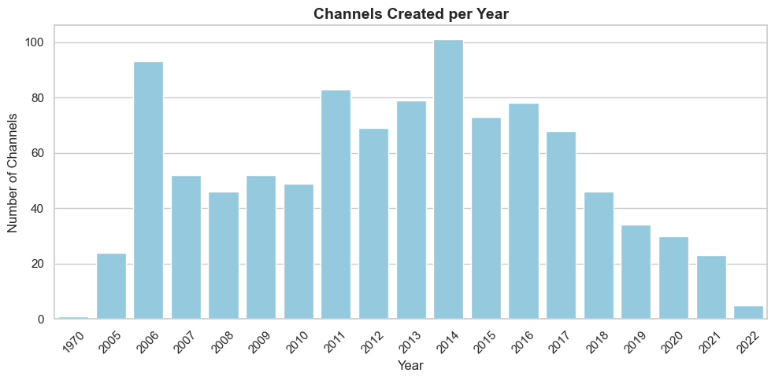
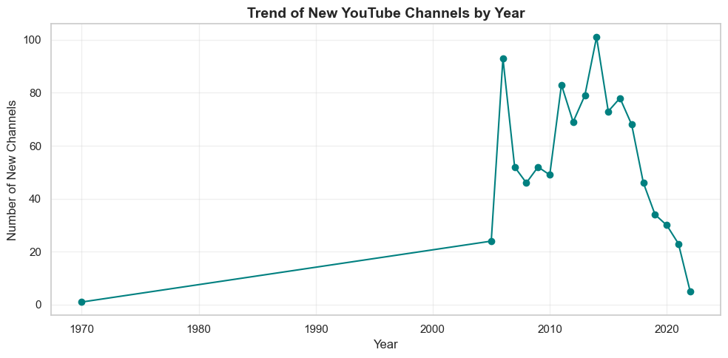
Trend over time on channel’s creation dates
The creation of new YouTube channels peaked around 2014, with both charts showing the highest number of channels—over 100—being created that year. After this peak, there is a noticeable and steady decline in the number of new channels created annually.
Channel creation rates were relatively low and stable before 2006, followed by a sharp increase, especially between 2006 and 2014. This demonstrates a rapid expansion phase for the platform in its early years before stabilizing and eventually declining in recent years.

Slide 13
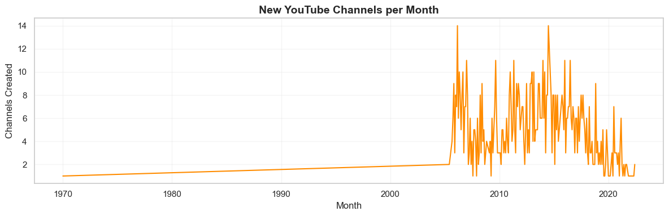
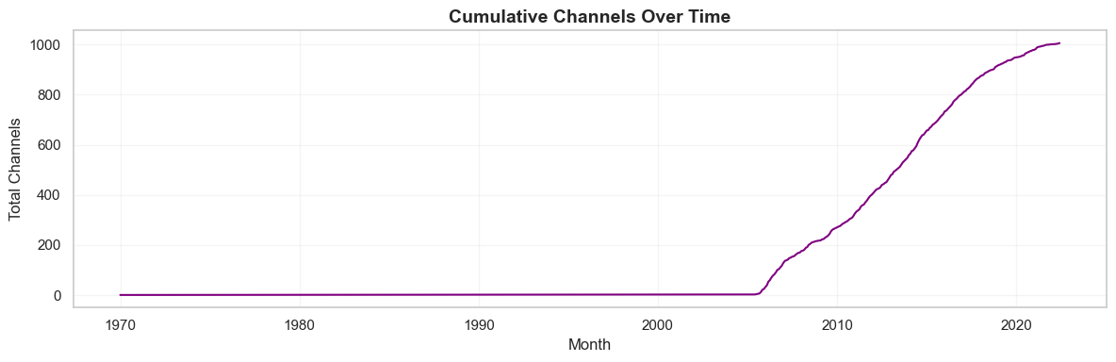
A dramatic surge in new YouTube channels began around 2005, with the monthly creation rate spiking sharply after years of little to no activity; this is reflected in the first plot, where monthly new channel counts jump from near zero to peaks above 10 post-2005.
The cumulative number of channels grew rapidly from 2005 onward, then began to plateau after 2020, as shown by the steep rise in the second plot that eventually levels out, indicating a slowdown in new channel creation in recent years

Slide 14
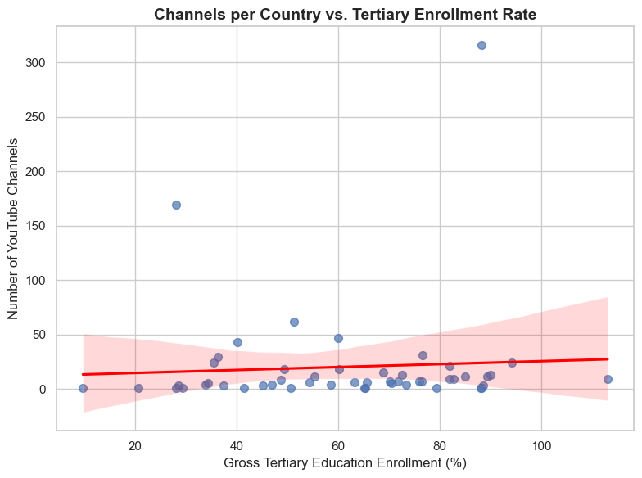
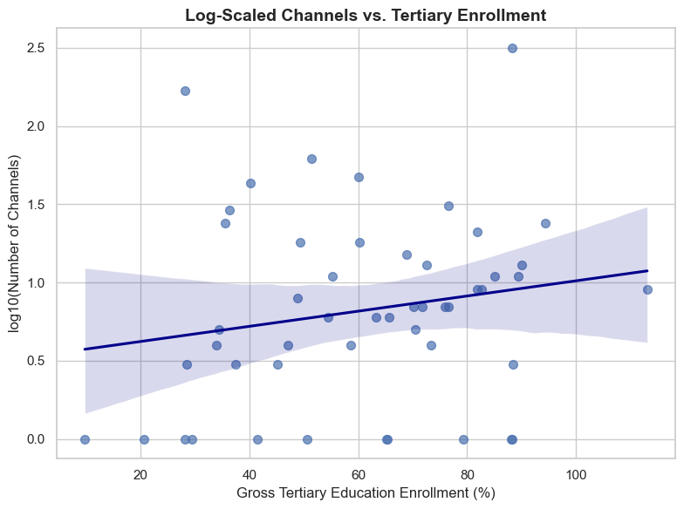
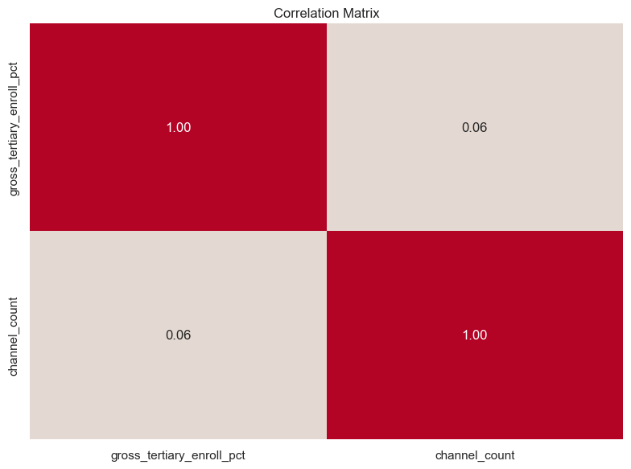
Relationship between gross tertiary education enrollment and the number of YouTube channels in a country
There is essentially no strong relationship between gross tertiary education enrollment rate and the number of YouTube channels per country, as reflected by the very low correlation coefficient of 0.06 in the correlation matrix. The scatter plots also show a wide dispersion in channel counts across countries, regardless of enrollment rate.
Some countries are notable outliers, with much higher YouTube channel counts than others at similar levels of tertiary education enrollment, as seen by the few points far above the main cluster in the first scatter plot. This suggests that factors other than educational enrollment, such as population size or cultural trends, may play a larger role in determining the prevalence of YouTube channels in a country.

Slide 15
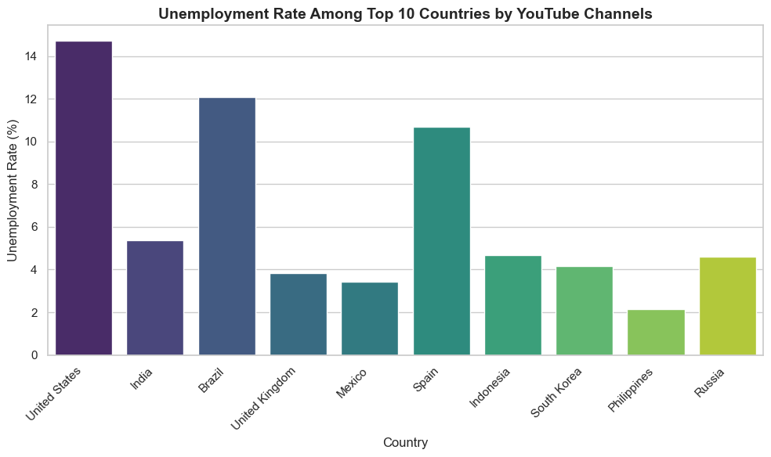
Unemployment rate variation among the top 10 countries with the highest number of YouTube channels
The United States has the highest unemployment rate among the top 10 countries by YouTube channels, surpassing 14%. This is a clear outlier compared to the other countries in the group.
The Philippines has the lowest unemployment rate in this set, at just above 2%, indicating significant variation in unemployment rates across the top YouTube channel-producing countries.

Slide 16
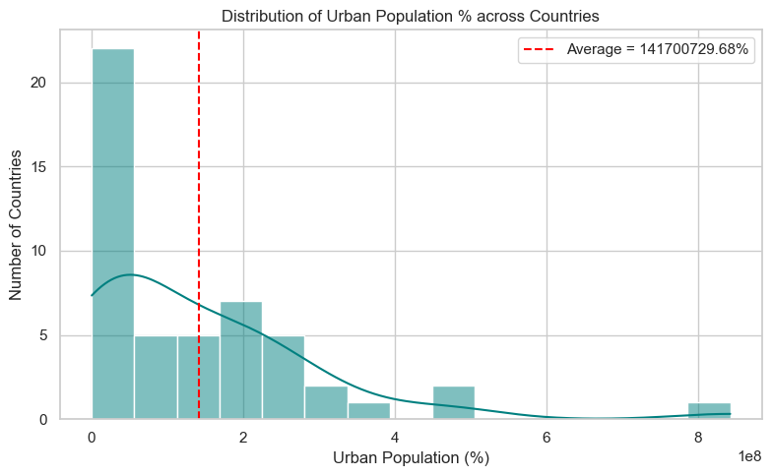
Average urban population percentage in countries with YouTube channels
The distribution of urban population across countries is heavily right-skewed, with the majority of countries having much lower urban populations, as shown by the high concentration of countries in the first few bins on the left.
The average urban population is significantly higher than the typical country's value, indicated by the red dashed average line falling far to the right of the most densely populated histogram bins—suggesting a few countries with extremely large urban populations are dramatically increasing the overall average.

Slide 17
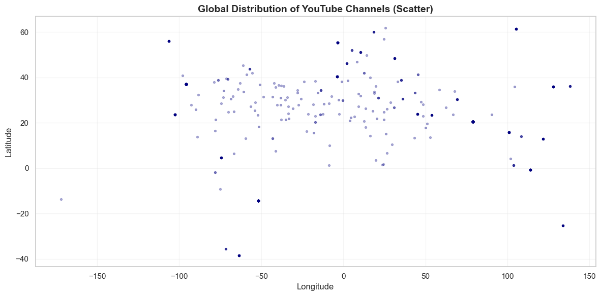
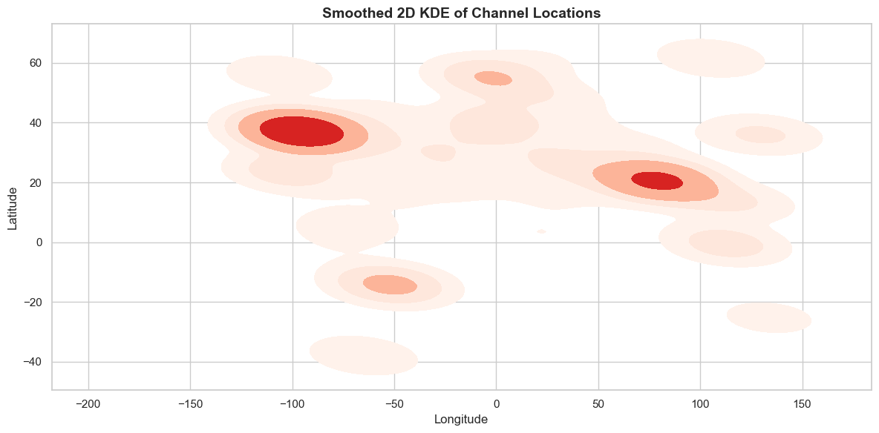
Patterns in the distribution of YouTube channels based on latitude and longitude coordinates
YouTube Channels Are Concentrated in North America, Europe, and South Asia
Both the scatter plot and the 2D KDE density plot show that the highest density of YouTube channels is found in North America (particularly around the United States), Western Europe, and South Asia (notably India). This is evident from the dense clustering of points as well as the pronounced red density areas in these regions.
Sparse Representation in the Southern Hemisphere and Remote Regions
There are notably fewer channels in the Southern Hemisphere (such as South America, Africa below the equator, and Australia) and in remote regions. The scatter plot reflects this with very few points below the equator or far from major landmasses, and the density plot visually confirms minimal activity outside the dominant clusters.

Slide 18
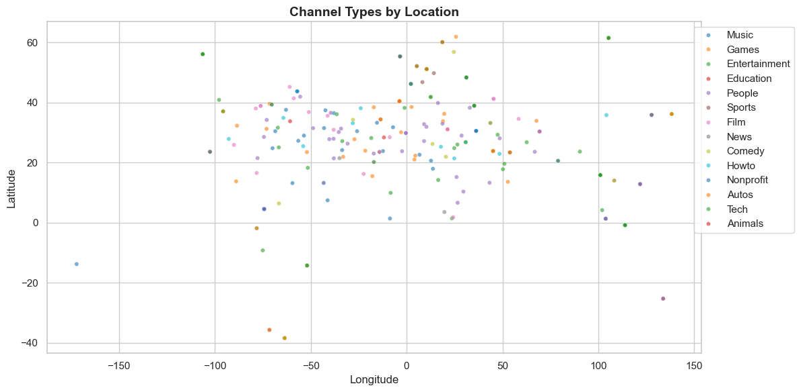
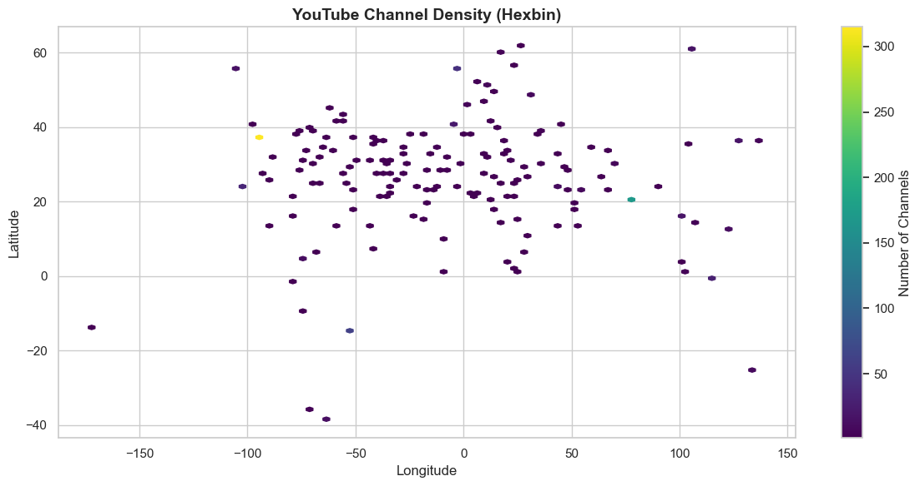
YouTube channels are heavily concentrated between 0° and 60° latitude and between -100° and 100° longitude, as both the scatter and hexbin plots reveal dense clustering in North America, Europe, and South Asia, with almost no channels in extreme southern or polar regions.
A wide diversity of channel types exists within these densely populated regions, as shown in the scatter plot—where nearly all categories (e.g., Music, Education, Entertainment) are distributed throughout the main channel clusters, indicating no strong geographic segregation by channel type

Slide 19
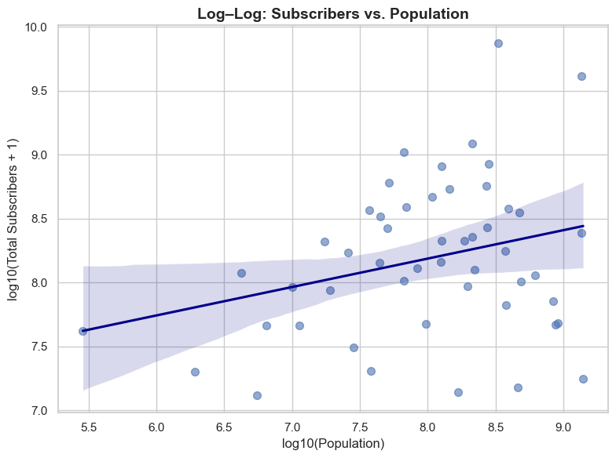
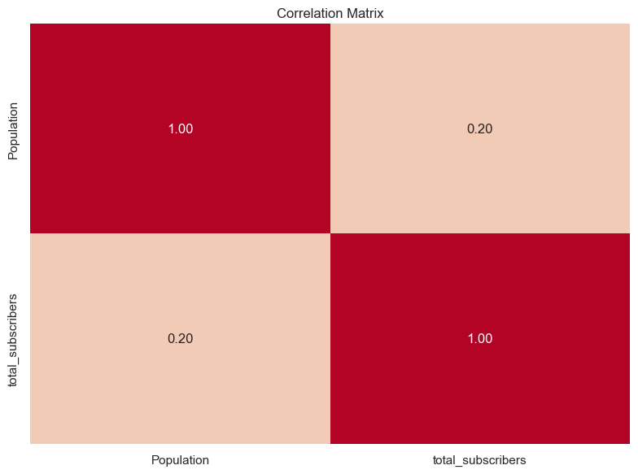
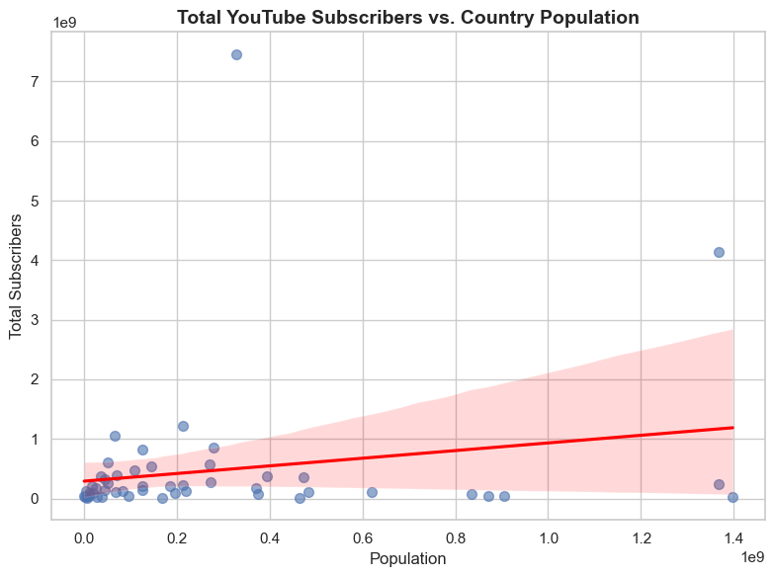
Correlation between the number of subscribers and the population of a country
Country Population and YouTube Subscribers Have Only a Weak Positive Relationship
The scatter plots and the correlation matrix reveal that there is only a weak positive correlation (correlation coefficient ≈ 0.20) between a country's population and the total number of YouTube subscribers attributed to that country. This suggests that while larger populations may offer a bigger potential audience, population alone does not strongly predict total YouTube subscribers at the country level.
Subscriber Distribution Shows Large Outliers and Variability Unrelated to Population
The scatter plots (both linear and log-log) display significant outliers and wide variability, where some countries with modest populations have disproportionately high subscriber counts, and some of the world's most populous countries have lower-than-expected subscriber numbers. This highlights that factors beyond population—such as digital penetration, cultural engagement with YouTube, and creator activity—play a critical role in subscriber totals.

Slide 20
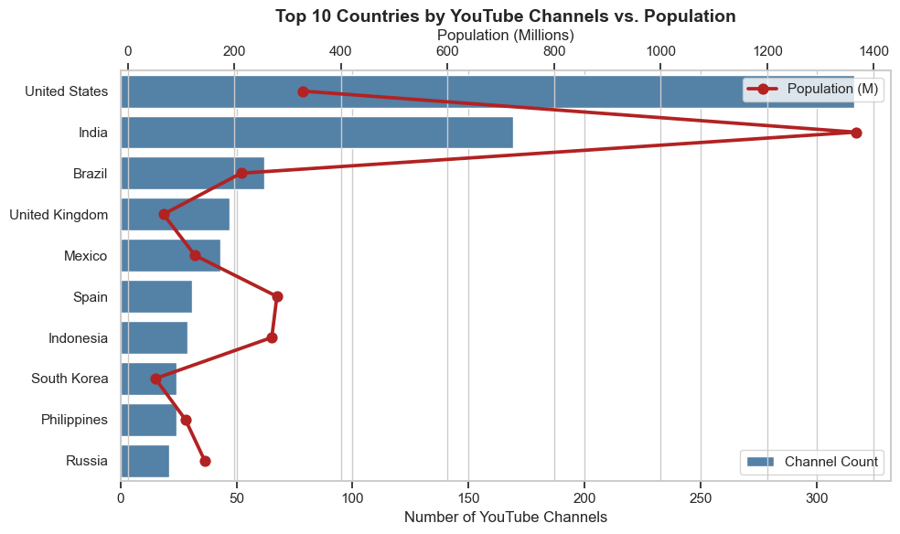
Top 10 countries with the highest number of YouTube channels compare in terms of their total population
The United States has the highest number of top YouTube channels despite not having the largest population. The U.S. vastly outpaces all other countries in the number of YouTube channels, with more than 300 channels, even though its population is significantly smaller than India’s. This indicates a much higher density of popular YouTube channels per capita in the United States.
Population size does not strongly predict YouTube channel count among the top countries. Countries like India and Brazil have very large populations but relatively fewer top YouTube channels compared to the U.S. Meanwhile, countries with smaller populations—such as the United Kingdom and Spain—still appear among the top 10, showing that factors other than just population size play a key role in YouTube channel proliferation.

Slide 21
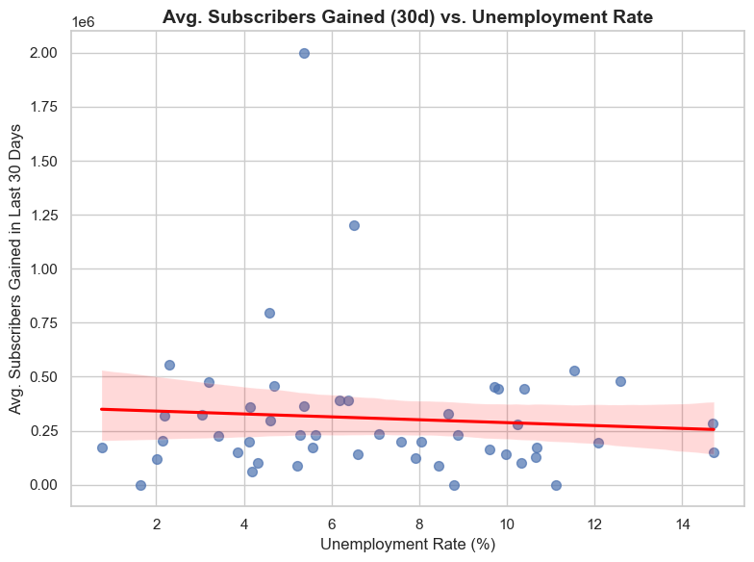
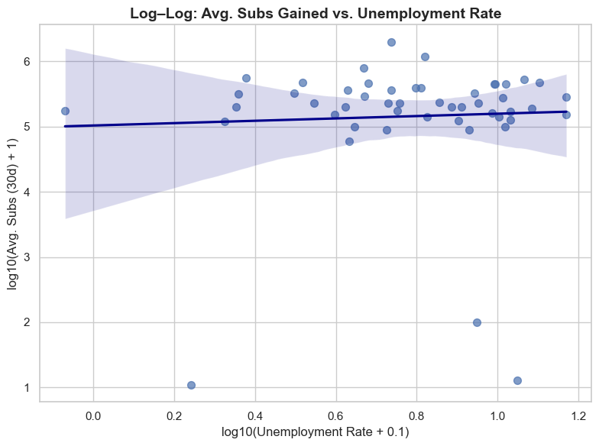
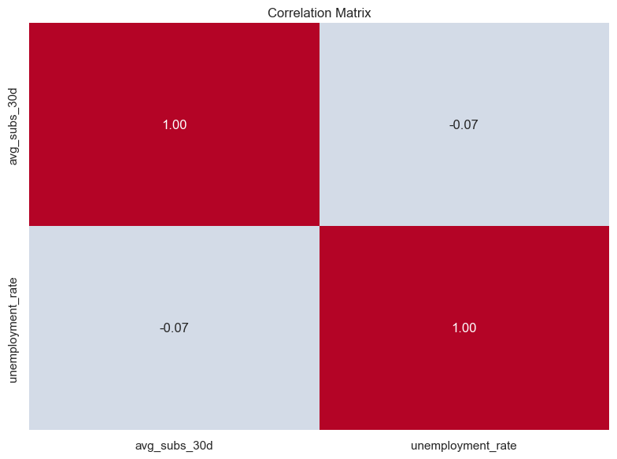
Correlation between the number of subscribers gained in the last 30 days and the unemployment rate in a country
There is virtually no relationship between a country’s unemployment rate and the average number of subscribers gained by YouTube channels in the last 30 days.This is supported by the very low correlation coefficient of -0.07 in the correlation matrix, as well as the flat trend lines in both the linear and log-log scatter plots.
Channels across all unemployment rates show a wide spread in subscriber gains, with several extreme outliers well above the general trend.The scatter plots reveal that, regardless of unemployment rate, some countries have channels that experience exceptionally high subscriber growth, indicating that factors other than unemployment are likely driving subscriber gains

Slide 22
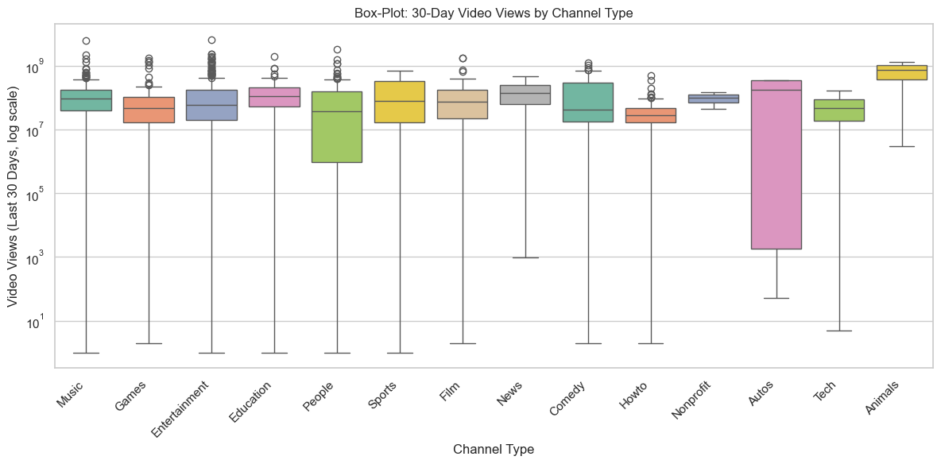
Distribution of video views for the last 30 days vary across different channel types
The "Animals" and "Sports" channel types achieve the highest median video views in the last 30 days, as their box plots are positioned highest on the log scale, indicating these categories tend to garner more views compared to others.
The "Autos" category displays the greatest variability in 30-day video views, with a notably wide box and long whiskers, reflecting both some of the lowest minimums and high maximum outliers among all channel types.

Slide 23
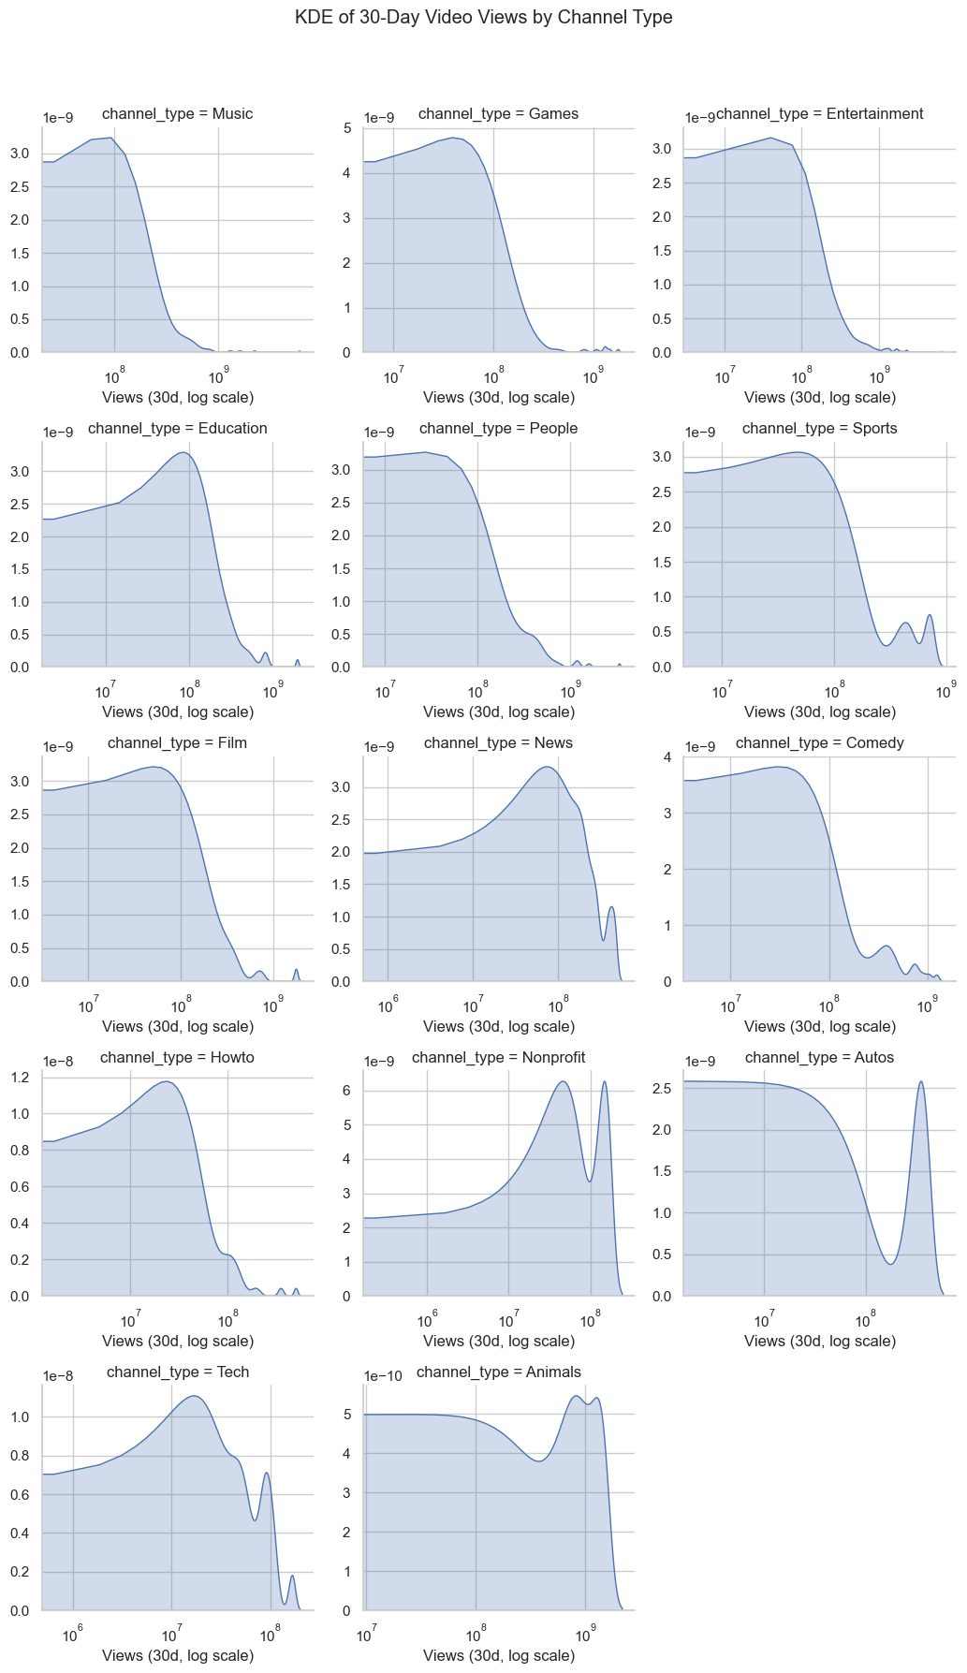
Most Channel Types Have a Heavy Concentration of Channels with Lower 30-Day Views.
For nearly all channel types, the distribution peaks sharply at the lower end of the view scale (typically between 106106 and 107107 monthly views), then drops off quickly, indicating that the vast majority of channels have relatively modest recent view counts regardless of type. Only a small fraction of channels reach very high monthly view numbers.
Channel Types Like "Nonprofit," "Animals," and "Sports" Exhibit Significant Outliers and Bimodal Patterns.
While most categories are dominated by lower views, "Nonprofit," "Animals," and "Sports" show pronounced bumps or secondary peaks at much higher view ranges (108108 to 109109), indicating the presence of a distinct group of channels that achieve exceptionally high recent viewership within these types—much more so than most other categories. This suggests these types include both many niche channels and a few that attract mass audiences.

Slide 24
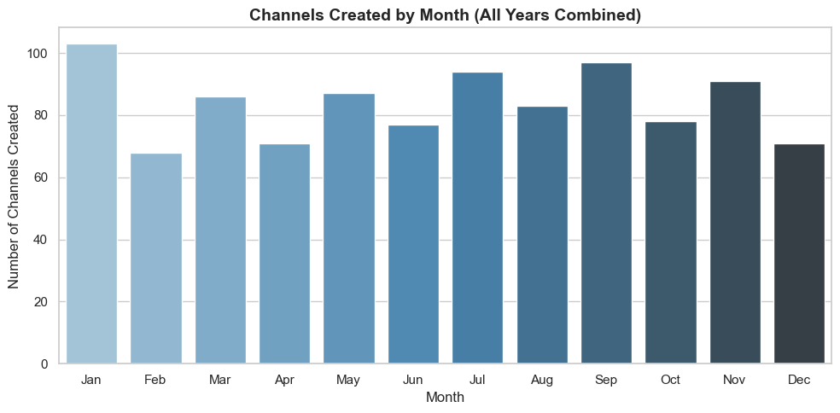
Seasonal trends in the number of videos uploaded by YouTube channels
The highest number of YouTube channels are created in January, with over 100 channels started, making it the most popular month for new channel creation.
February shows the lowest channel creation activity, with significantly fewer new channels compared to other months, highlighting a notable dip early in the year.

Slide 25
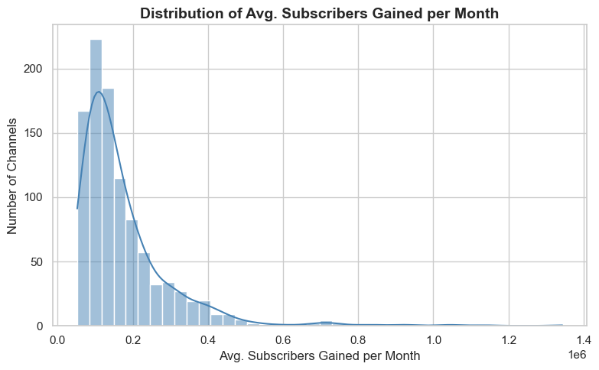
Average number of subscribers gained per month since the creation of YouTube channels till now
The distribution of average subscribers gained per month is highly right-skewed, with most channels gaining between 50,000 and 200,000 subscribers monthly, and only a small number of channels achieving much higher growth.
A sharp peak is observed around 125,000 average monthly subscribers gained, after which the number of channels declines rapidly as average subscriber gains increase, indicating that exceptionally high monthly growth is rare among channels.

Slide 26
Thank you

